Slide 1









Campus
Synergy
Enhancing College Club Engagement

Slide 2




Our Team
N. Ajay Kumar (23r21a05d0)
ch. sai swetha (23e21a05d7)
k. pravallika (23r21a05f8)
k. lokansh reddy (23r21a05f9)
K. Sai Vardhan (23r21a05g1)

Slide 3








project Theme
EduTech
Web and App Platform

Slide 4




Project Overview
Welcome to the Campus Synergy presentation.
Our project aims to address the challenges in college club and event communication.

Slide 5

Problem Statement
In college community, club information and communication are fragmented, making it challenging for students to stay informed and engaged.

Slide 6

solution
Our solution involves developing a centralized web platform that streamlines communication, ensuring that club information and event details are easily accessible to all students, including social media integration.

Slide 7




Project Goals
Our goals are to:
Create a user-friendly platform.
Foster active student engagement.
Centralize club information.

Slide 8




Key Features
Centralized Information Hub
Club Profiles
Event Calendar
News Feed
User-Friendly Registration
Social Media Integration
Promotion Ease

Slide 9

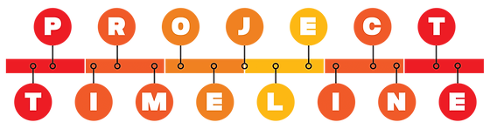


Week 1-2: Project Intiation
Week 3-4: Design & Development
Week 5-6: Profiles and Event Functionality
Week 7: Engagement Features
week 8: Testing & Launching of Prototype

Slide 10

















SWOT ANALYSIS
S
W
O
T
Strenghts
Weaknesses
Oportunities
Threats
1. Centralized Information Hub
2. User Engagement
3. Real-time Updates
4. Simplified Event Registration
5. Social Media Integration
1. Initial Adoption
2. Maintenance
3. Technical Challenges
1. Growth Potential
2. Community Building
3. Promotions
4. Feedback Loop
1. Privacy and Security Concerns
2. User Resistance

Slide 11
TEchstack
HTML
CSS
JAVSCRIPT
BOOTSTRAP Framework
Git Hub

Slide 12
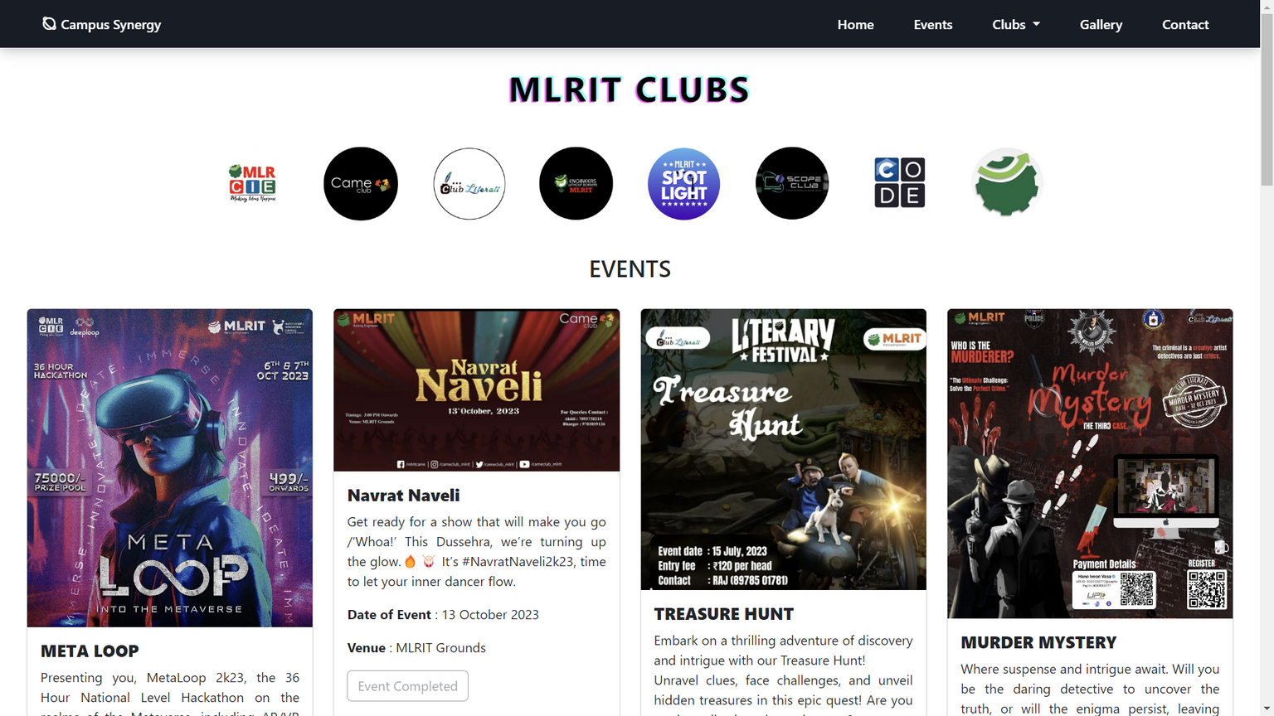
Prototype

Slide 13
Thank You

